Slide 1
Econometry
By CodeGrammer
Admin
General
Exit

Slide 2
Login
Register
Back

Slide 3


Econometry
By CodeGrammer
Credits Transfer
Online Shopping
Bill Payment
Manual
Contributers
Connection Lost?
Offline Game
Exit

Slide 4
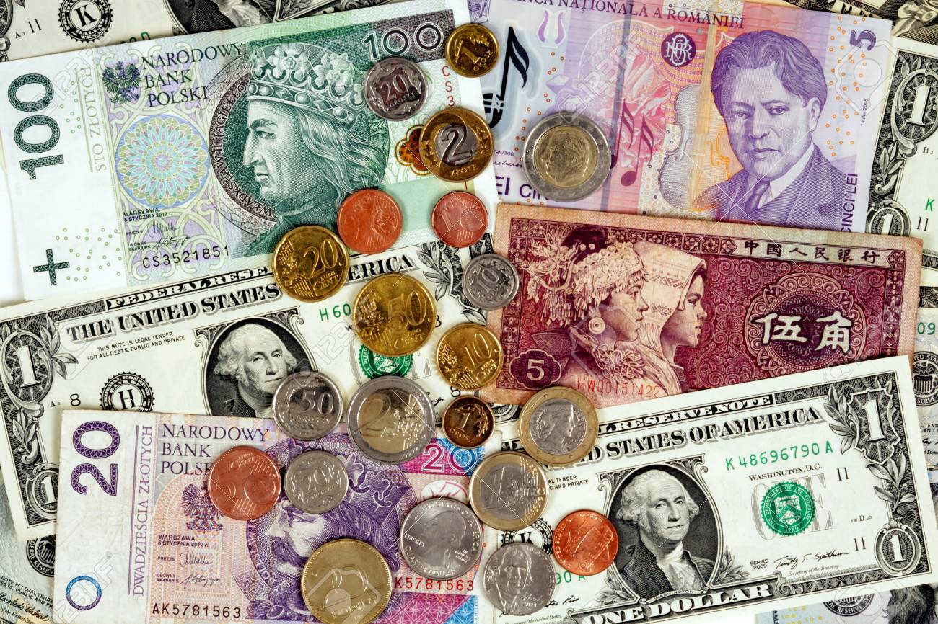
Choose Service
Bkash
DBBL Card
Back

Slide 5
Choose Option
Transfer
Mobile Recharge
receive
Back

Slide 6
Balance :
10000
Phone Number :
01776670525
Amount :
1500
Receiver Number :
01712545674
Pin Number :
*****
Confirm
Back

Slide 7
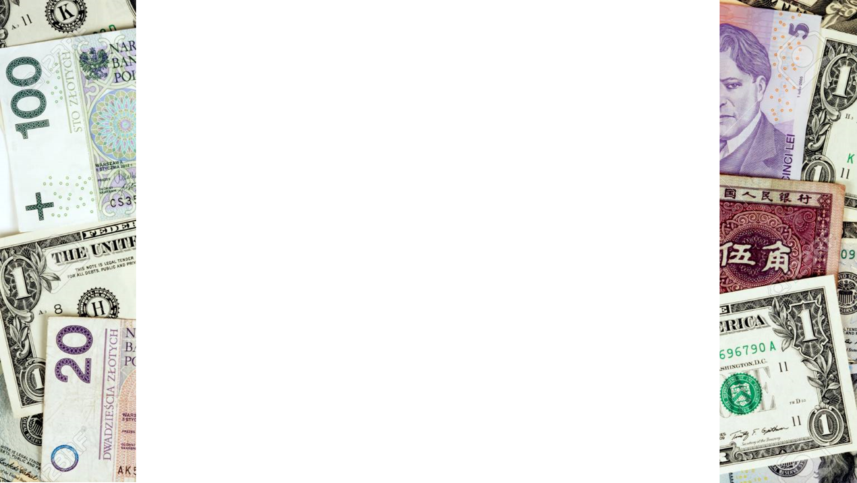
Balance :
8500
Transfer Successful!
Back

Slide 8
Choose Option
Transfer
Mobile Recharge
receive
Back

Slide 9
Balance :
8500
Recharge Amount :
150
Receiver Number :
01712545674
Pin Number :
*****
Confirm
Back

Slide 10
Balance :
8450
Recharge Successful!
Back

Slide 11
Choose Service
Bkash
DBBL Card
Back

Slide 12
Choose Option
Transfer
receive
Back

Slide 13
Balance :
8450
Account Number :
145671
Amount :
2000
Pin Number :
*****
Confirm
Back

Slide 14
Balance :
6450
Transfer Successful!
Back

Slide 15
Econometry
By CodeGrammer
Credits Transfer
Online Shopping
Bill Payment
Manual
Contributers
Connection Lost?
Offline Game
Exit

Slide 16
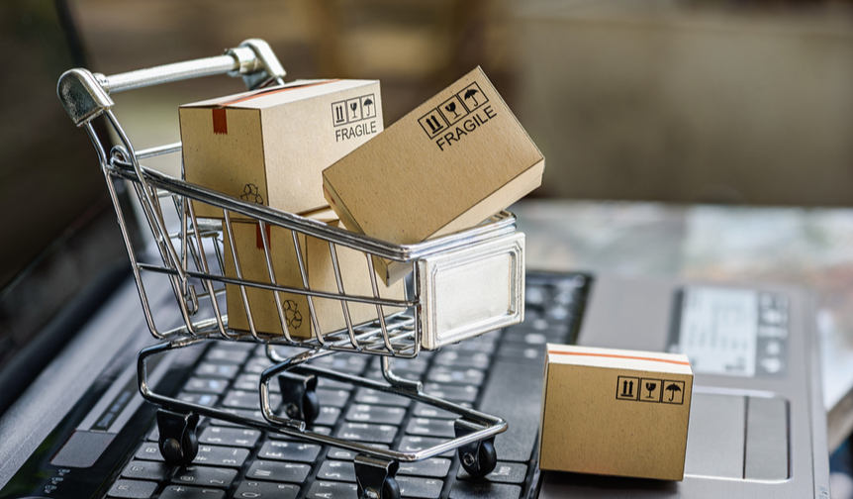
Choose Option
Food
Medicine
Cloths
Accessories
Back

Slide 17
Balance :
6450
1. Rice
Amount :
2
In kg
60 taka/kg
2. Hilsa Fish
0
Amount :
1000 taka/piece
3. Chicken
Amount :
2
450 taka/piece
Confirm
Back

Slide 18
Balance :
6450
Delivery Charge 100 taka
Address :
425/c, Khilgaon, Dhaka
Confirm Purchase
Back

Slide 19
Balance :
5330
Shopping Successful!
List of Shopping :
2 kg of Rice = 120/-
2 piece of Chicken = 900/-
Delivery Charge = 100/-
Total = 1120/-
Back

Slide 20
Econometry
By CodeGrammer
Credits Transfer
Online Shopping
Bill Payment
Manual
Contributers
Connection Lost?
Offline Game
Exit

Slide 21
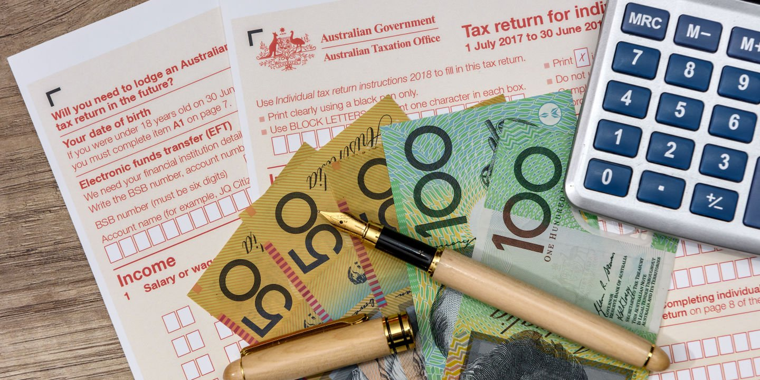
Choose Option
Electric Card Recharge
Water Bill Payment
Gas Bill Payment
Back

Slide 22
Balance :
5330
Card Number :
1456752
Amount :
2000
Pin Number :
*****
Confirm
Back

Slide 23
Balance :
3330
Recharge Successful!
Back

Slide 24
Choose Option
Electric Card Recharge
Water Bill Payment
Gas Bill Payment
Back

Slide 25
Balance :
3330
ID Number :
1456752
Bill :
1500
Amount :
1500
Pin Number :
*****
Confirm
Back

Slide 26
Balance :
1830
Payment Successful!
Bill Remaining :
0
Back

Slide 27
Econometry
By CodeGrammer
Credits Transfer
Online Shopping
Bill Payment
Manual
Contributers
Connection Lost?
Offline Game
Exit

Slide 28
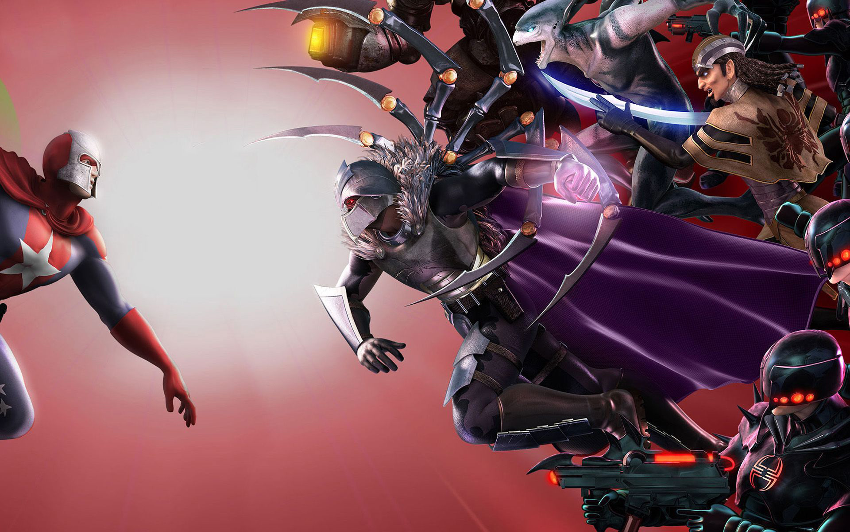
WordWAR Gorund
Hero HP:
100
Letho’s HP:
46
Health Poison:
3
“Letho has appeared!”
Major, there is an enemy. What do you like to do?
Attack
Drink Health Poison
Run

Slide 29
WordWAR Gorund
Hero HP:
83
Letho’s HP:
17
Health Poison:
3
Major, you strike Letho for 29 damage
Letho has given you 17 damage
Major, there is an enemy. What do you like to do?
Attack
Drink Health Poison
Run

Slide 30
WordWAR Gorund
Hero HP:
53
Letho’s HP:
0
Health Poison:
4
Major, you strike Letho for 37 damage
Letho has given you 30 damage
“Letho was defeated!”
Letho left a health poison
Major, what do you like to do now?
Continue Fighting
Exit Ground

Slide 31
WordWAR Gorund
Hero HP:
53
Dark Ganon’s HP:
68
Health Poison:
4
“Dark Ganon has appeared!”
Major, there is an enemy. What do you like to do?
Attack
Drink Health Poison
Run

Slide 32
WordWAR Gorund
Hero HP:
83
Dark Ganon’s HP:
68
Health Poison:
3
Healed yourself for 30 amount
Major, there is an enemy. What do you like to do?
Attack
Drink Health Poison
Run

Slide 33
THE END!

